Slide 1
Diabetes
Kellie Liu, Tony Tao, Elan Guo

Slide 2
Contents
Intro to Diabetes
Prevalence of Diabetes
Diabetes Indicators
Conclusion

Slide 3
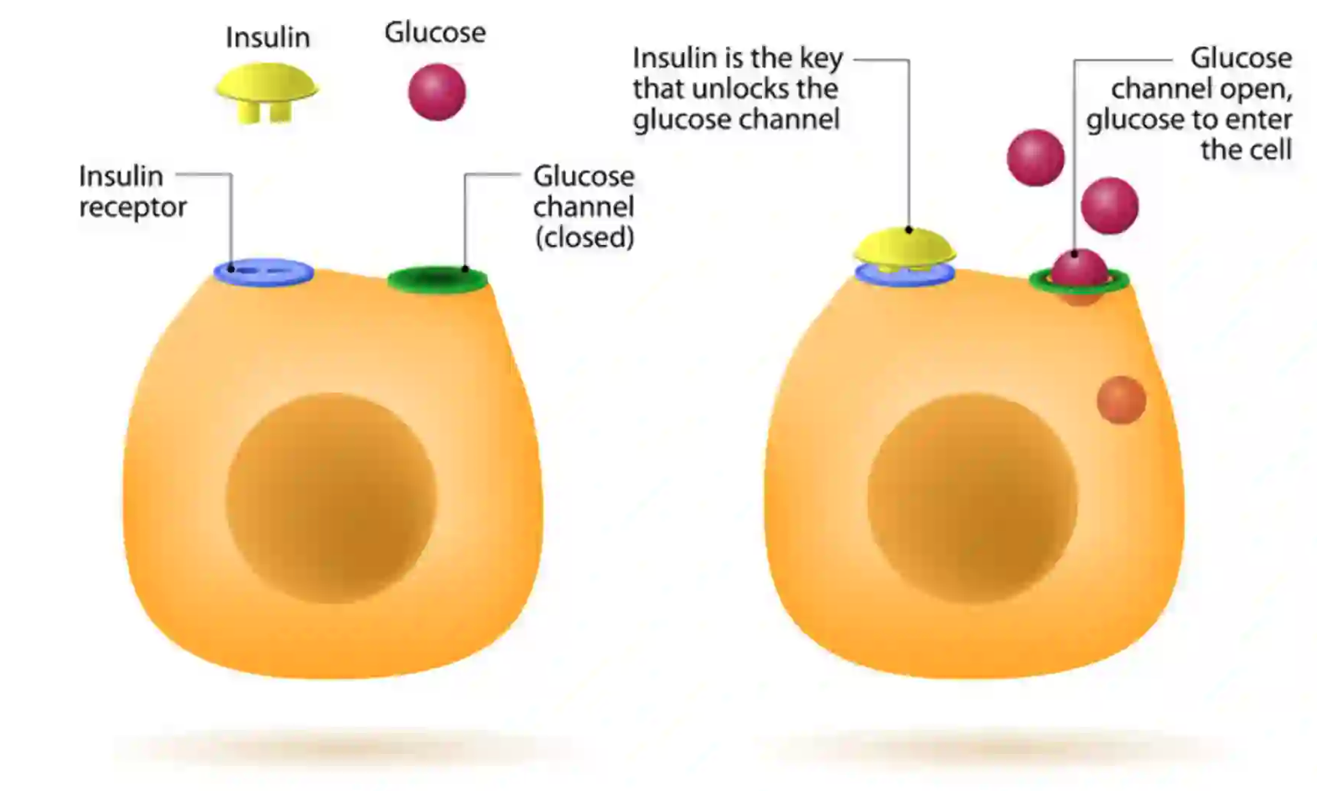
Intro

Slide 4
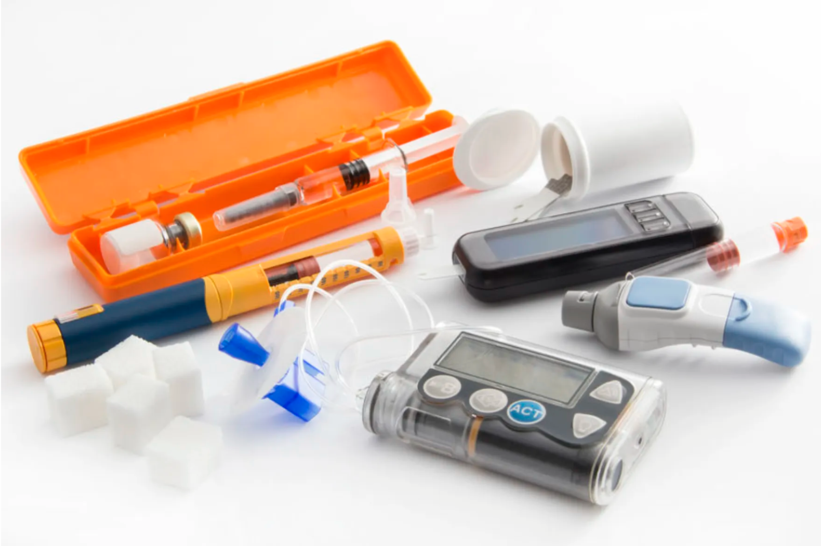

Type 1 & Type 2 diabetes

Slide 5
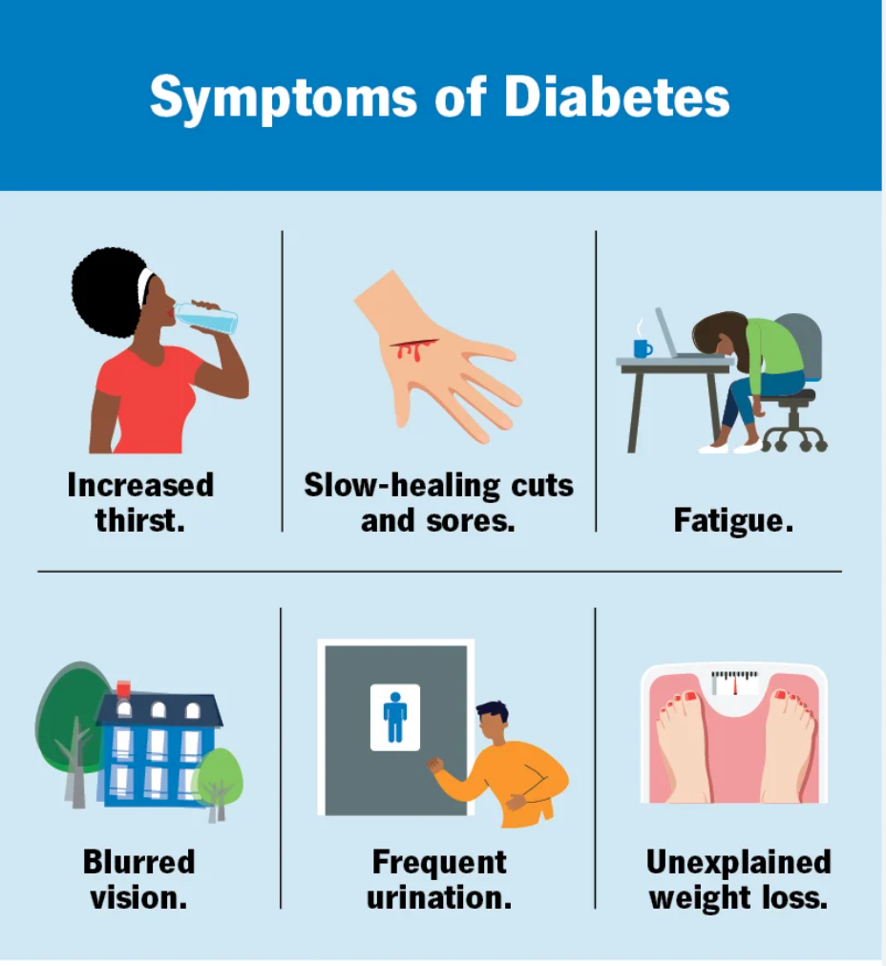
Effects

Slide 6

US Diabetes by County, 2004

Slide 7
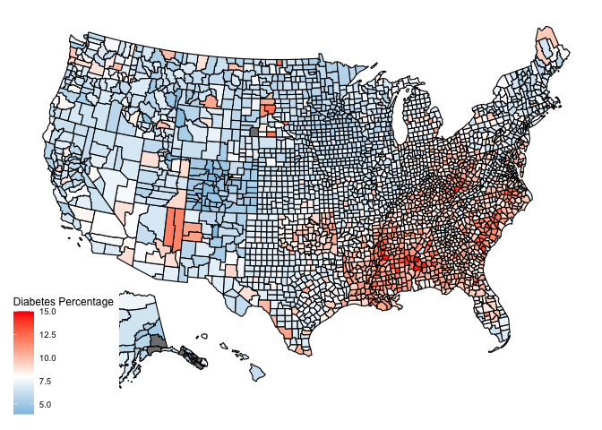
US Diabetes by County, 2008

Slide 8
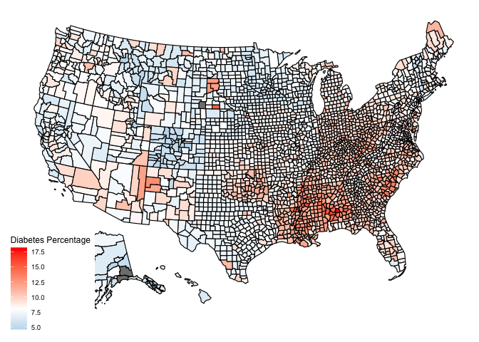
US Diabetes by County, 2012

Slide 9

US Diabetes by County, 2016

Slide 10

US Diabetes by County, 2020

Slide 11
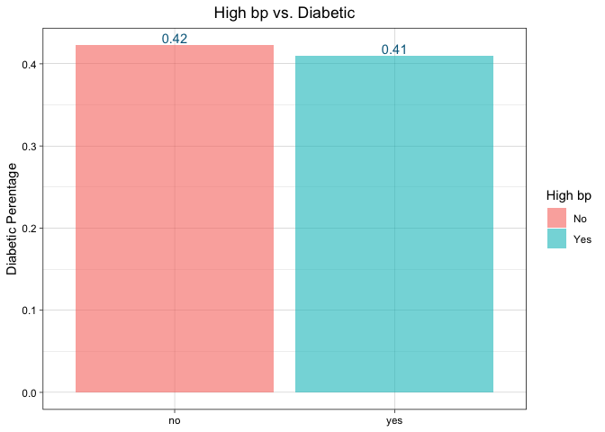
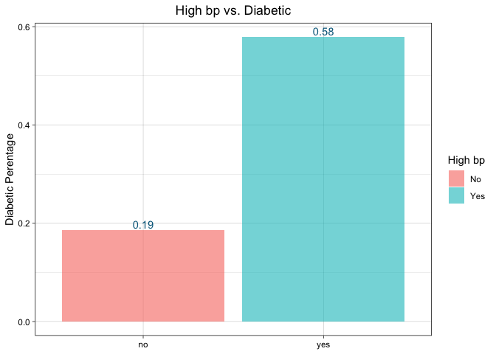
High Blood Pressure vs. Diabetes

Slide 12
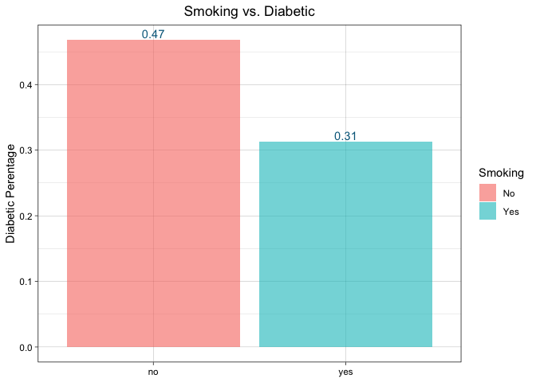
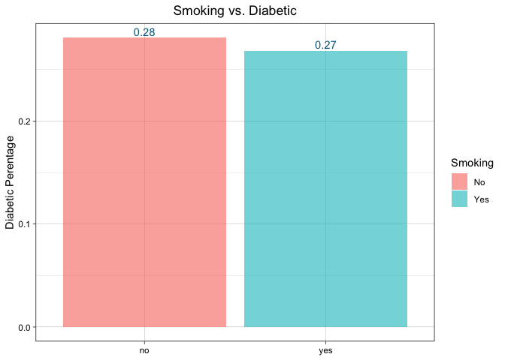
Smoking vs. Diabetes

Slide 13
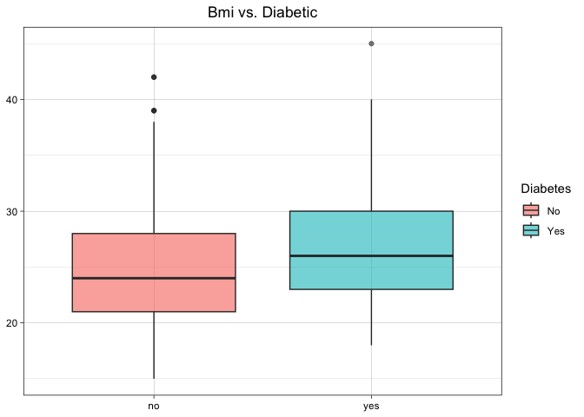
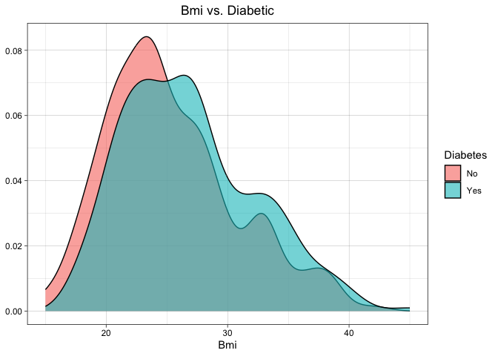
BMI VS. DIABETES

Slide 14
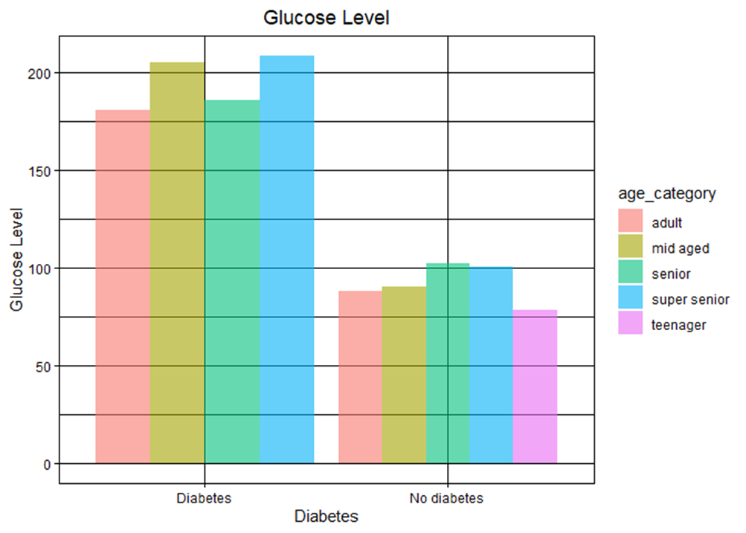
Mean Glucose Level vs. Diabetes
Typically, fasting blood sugar test is below 100 mg/dl
Impaired: 100~125 mg/dl
Diabetic: >126 mg/dl
Notes:
There are different ways to monitor blood sugar level and check whether one’s diabetic or not, our graph is according to fasting blood sugar test.
Fasting Blood Sugar Test measures of blood sugar after an overnight fast (not eating).
For non-diabetic people, their mean glucose level mainly fall under 100, while for diabetic people, they have a mean glucose level over 150.
Impaired: Impaired glucose tolerance
Mg/dl: Milligrams per decilitre
Under normal circumstances, when the glucose levels in your bloodstream rise, such as after a meal, your pancreas secretes insulin which prompts your body to absorb the excess glucose until the levels return to normal. But if you have diabetes, like type 1 diabetes, the pancreas either doesn't produce insulin, or like type 2 diabetes, the body fails to respond to insulin effectively. Then that can leave your blood sugar too high for too long. Over time, this can cause damage to blood vessels and nerves, and may lead to the development of heart disease and other complications over time.

Slide 15
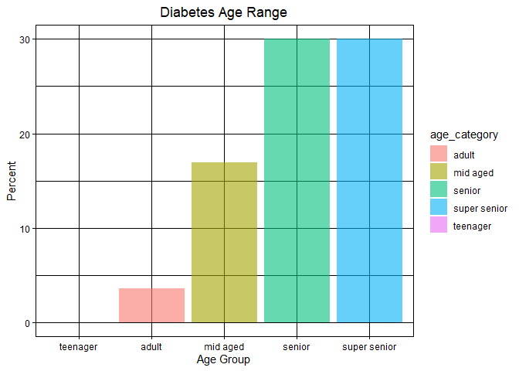
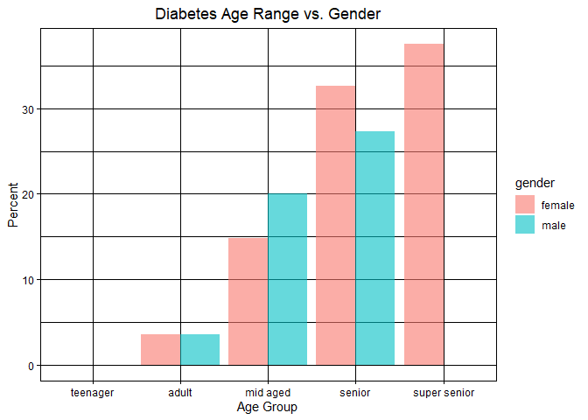
Age Range vs. Diabetes
Notes:
4 categories: age<=19~"teenager", for age between 20 & 40~"adult", for age between >=40 &<60~"mid aged", for age between >=60 & <80~"senior", age>=80~"super senior"
Older adults are at high risk for the development of diabetes, and multiple medical conditions, including high blood pressure and high cholesterol, occur at this age, too. That can make it even harder for people to keep their diabetes under control.
Diabetes can be worsen due to the combination of increasing insulin resistance and impaired pancreatic function with aging, these impairments can highly ruin the process of glucose absorption.

Slide 16
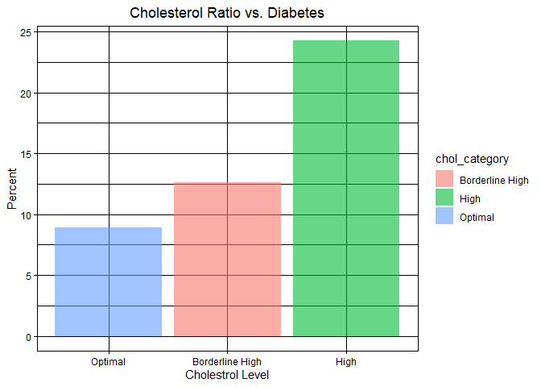
Cholesterol Level vs. diabetes
Indicators of Diabetes:
Decrease in the levels of HDL (good) cholesterol
Increase in the levels of triglycerides and LDL (bad) cholesterol
Cholesterol Ratio = Total Cholesterol / HDL (Good) Cholesterol
Notes:
This can indicate that diabetes leads to reducing the levels of HDL (beneficial, high-density lipoprotein) cholesterol while increasing the levels of triglycerides and LDL (harmful, low-density lipoprotein) cholesterol.
Eventually increase the risk for heart disease and stroke.
chol_ratio<=3.5~"Optimal", chol_ratio>=3.5 & chol_ratio<5~"Borderline High", chol_ratio>=5~"High"

Slide 17
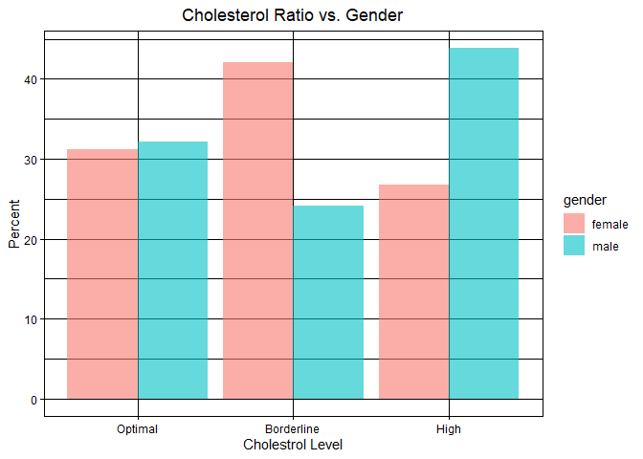
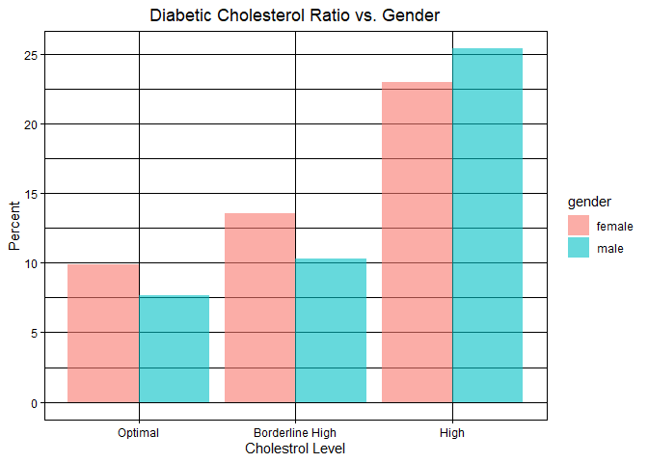
Cholesterol Level vs. diabetes

Slide 18
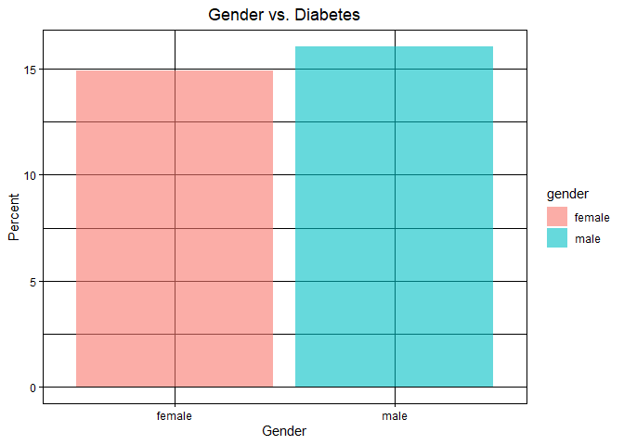
Gender Vs. Diabetes
Overall, no sex bias

Slide 19
Thank you

